Slide 1
Data mining for bio-chip analysis :
a study of breast cancer
Department of Computer Science and Information Engineering
Student : Kai-Yun Ku
Director : Chia-Yen Lee, Ph.D.

Slide 2
Outline
Introduction
Methodology
Application – for breast cancer
Conclusion
。background & motivation
。objective
。Research framework
。Clustering
。Neural network
。Decision tree

Slide 3
Introduction
- Background & Motivation :
Breast cancer is the most common cancers in women worldwide, about 50 million people in the world died of breast cancer a year. Whether breast cancer relapses or not is an important issue, so is there a simple way to know the information?
- Objective :
I find the dataset about patients who had developed distance metastases within 5 years or not on Internet. There are many samples which contain 24481 genes, can we construct a model if you give those genes and the model will tell you relapse or not? And I want to find the critical genes to help us predict.

Slide 4
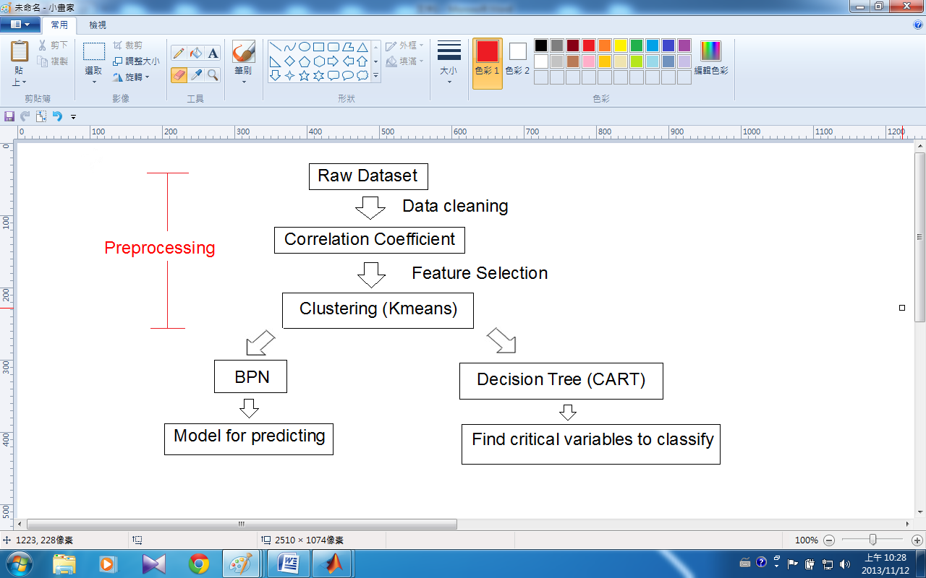
- Workflow :
Methodology

Slide 5
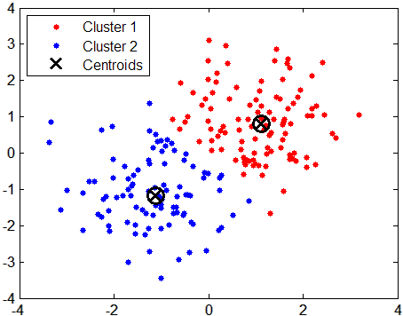
Methodology
- Clustering :
。K-means clustering :
the algorithm is composed of the following steps:
1. Place K points into the space represented by the objects that are
being clustered. These points represent initial group centroids.
2. Assign each object to the group that has the closest centroid.
3. When all objects have been assigned, recalculate the positions of
the K centroids.
4. Repeat Steps 2 and 3 until the centroids no longer move. This
produces a separation of the objects
into groups from which the metric to
be minimized can be calculated.

Slide 6
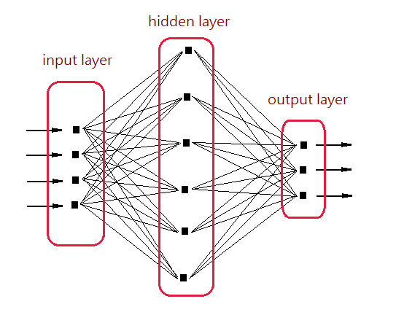
Methodology
- Neural network :
。 Think of it as of algorithms for "smart approximation”. The NNs are used in (to name few) universal approximation (mapping input to the output), tools capable of learning from their environment, tools for finding non-evident dependencies between data and so on.
。Backpropagation Neural Network (BPN):
- Initialization :
we need to create a network and to set the synaptic weight to some random values
- Feed forward the training patterns :
we want to have two different sets of data, one for “training” and one for “testing”,
the reason for that is simple – if we only test the NN on the same set of data, that
was used for the training, we do not know if it
learned to “predict” or to “memorize” the pattern.
- Backpropagation :
after the input pattern was presented to the
network and processed by all layers, we have
error( the difference between what we want and
what we got ) that can be used to adjust the
network.

Slide 7
Methodology
- Decision tree :
A decision tree is a decision support tool that uses a tree-like graph or model of decision.
。Classification And Regression Tree (CART) :
- binary tree
- key idea : recursive partitioning
。Select the variable/value (X=t₁) that produces the greatest “separation” in the target. (X=t₁) is called a “split”.
。If X< t₁ then send the data to the “left”; otherwise, send data point to the “right”.
。Repeat same process on these two “nodes”

Slide 8
Application – for breast cancer
- About raw dataset:
High-dimensional biomedical datasets.
The training data contains 78 patient samples, 34 of which are from patients who had developed distance metastases within 5 years (labelled as "relapse"), the rest 44 samples are from patients who remained healthy from the disease after their initial diagnosis for interval of at least 5 years (labelled as "non-relapse").
Correspondingly, there are 12 relapse and 7 non-relapse samples in the testing dataset. The number of genes is 24481 and we extracted values of "Ratio" from original microarray data with the replacement of all "NaN" to 100.0.
- “Kent Ridge Bio-medical Dataset”, available at:
” http://datam.i2r.a-star.edu.sg/datasets/krbd/index.html”, asscessed on November.1.2013

Slide 9
- Preprocessing
Application – for breast cancer
Data cleaning (to remove incomplete data)
Output : relapse => 1
non-relapse => 0
Use correlation coefficient about input( 24188 genes )and output , then extract 1242 genes as the new dataset（correlation coefficient > 0.25 and <-0.25 ),the reason for that is simple, if the input variable has little effect on the output，so I don’t choose the variable as input to construct the model.
New dataset : 1242 genes as variables，96 samples => k-means
50 variables version
100 variables version
300 variables version

Slide 10
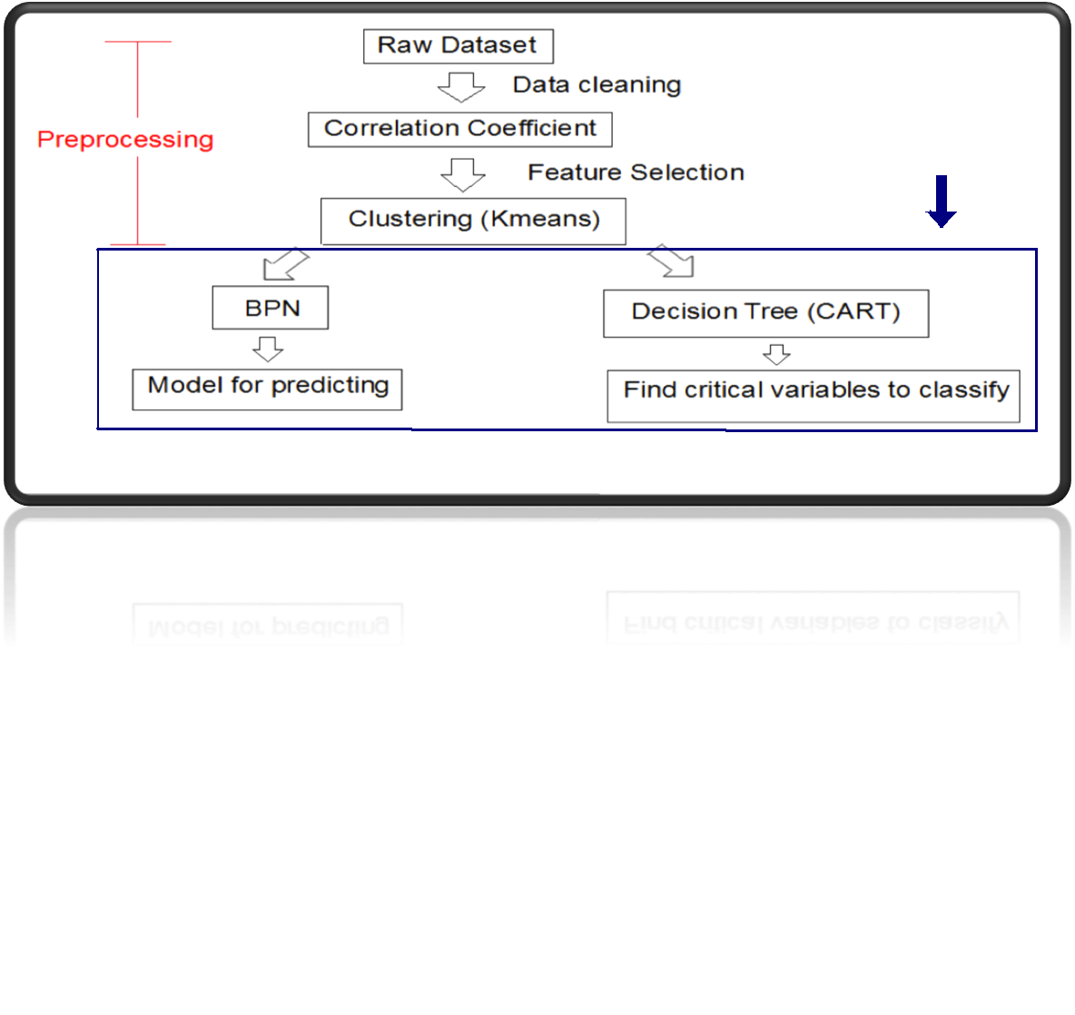

Slide 11

- Classification tree analysis :
Application – for breast cancer
Purpose : To find the critical variables which are useful when we predict the patient whether relapse or not
As the figure 1 , figure 2 , figure 3 , we can conclude:
> gene name:
1. AL080059:Continuous < -0.1935
and => output : 1 - support :
NM_013438:Continuous >= 0.1505 (relapse) confidence : 100%
2. AL080059:Continuous >= -0.1935
and => output : 0 - support :
Contig46934_RC : continuous >=0.34 (non-relapse) confidence : 75%
3. AL080059:Continuous >= -0.1935
and
NM_013438:Continuous < 0.1505 => output : 1 - support :
and (relapse) confidence : 100%
NM_020244 : continuous < -0.546

Slide 12
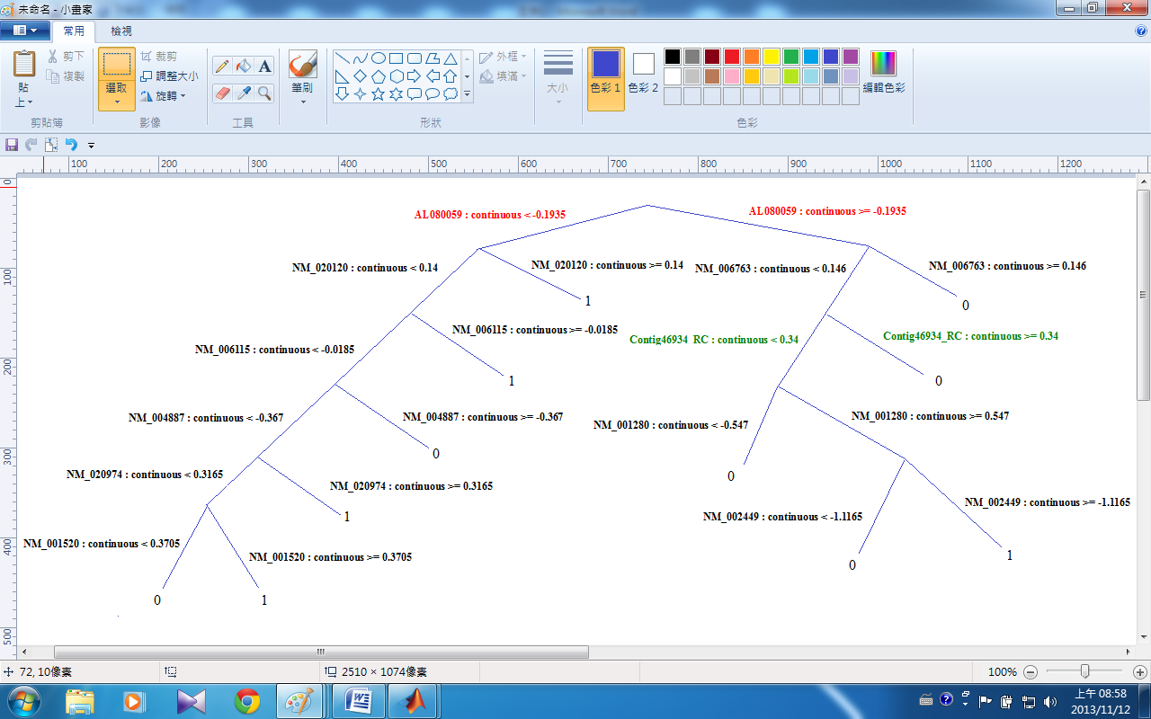
- 50 Variables : classification tree
Application – for breast cancer
Figure 1

Slide 13
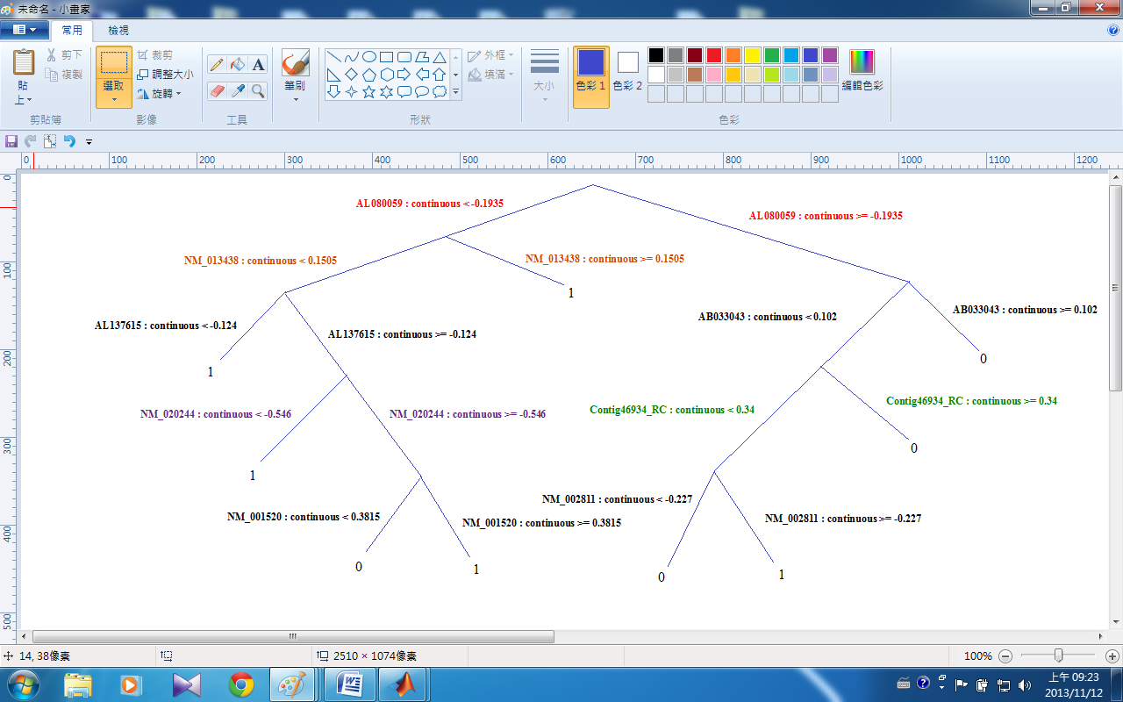
- 100 Variables : classification tree
Application – for breast cancer
Figure 2

Slide 14
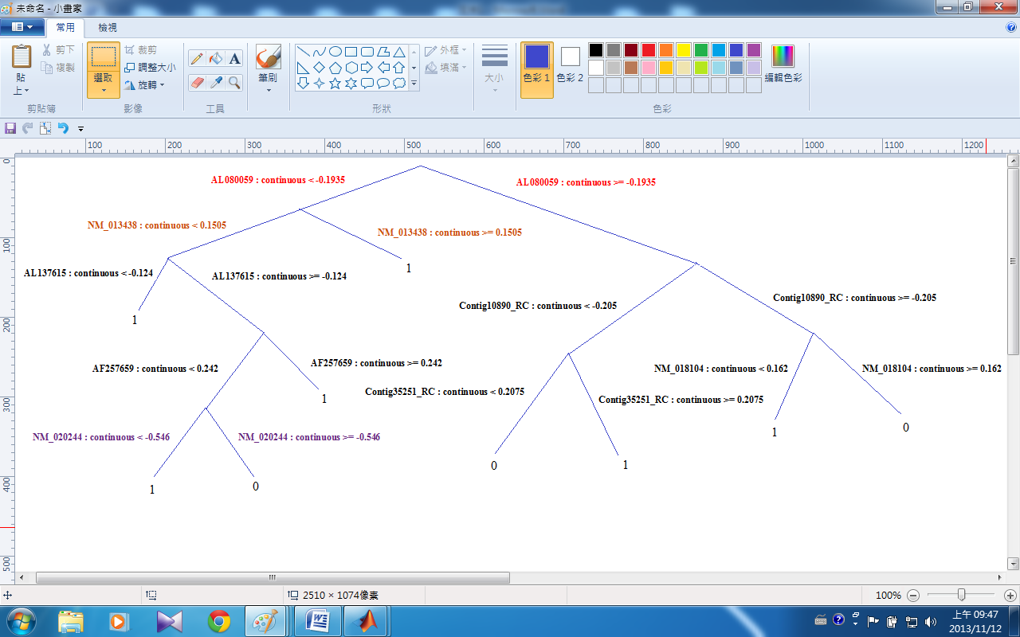
- 300 Variables : classification tree
Application – for breast cancer
Figure 3

Slide 15
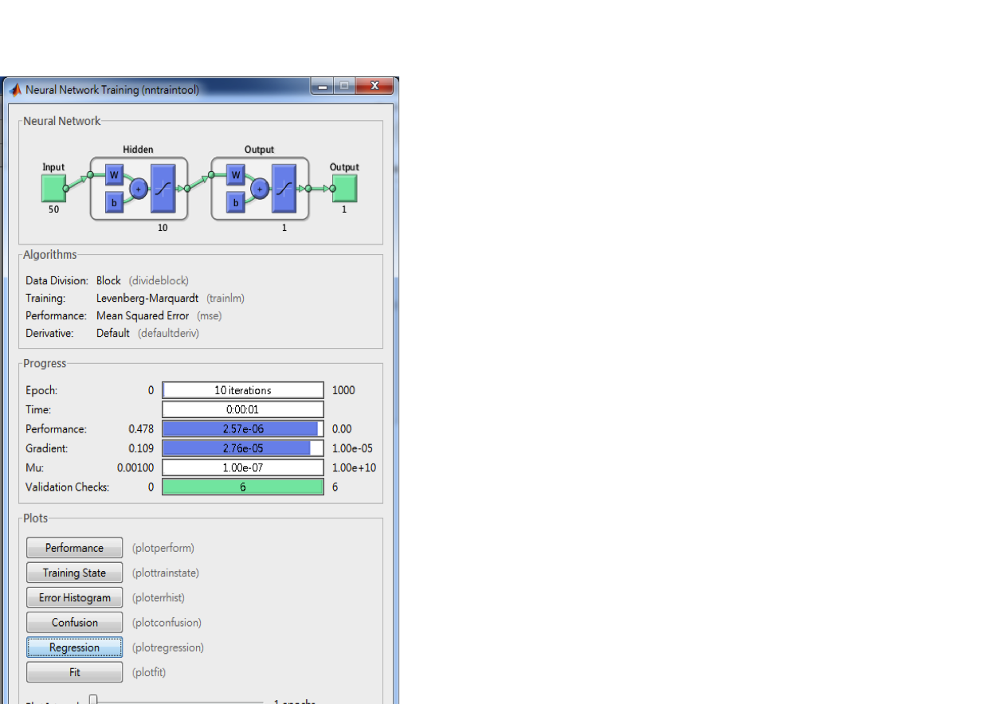
- Model user interface provided by MATLAB introduction :
Application – for breast cancer
- User interface provided by matlab nntool box :
> neural network architecture
> algorithms : data division ( training , validation, testing )
> performance : Mean Squared Error ( MSE )
> progressing information
> result
Show some interfaces with different
parameters about 50 variables ,
100 variables , and 300 variables
」

Slide 16
-Divide Data for Optimal Neural Network Training :
Application – for breast cancer
Training Set: this data set is used to adjust the weights on the neural network.
Validation Set: the error on the validation set is monitored during the training process. Validation error normally decreases during the initial phase of training, as does the training set error. However, whenthe network begins to overfit the data, the error on the validation set typically begins to rise.
Testing Set: this data set is used only for testing the final solution in order to confirm the actual predictive power of the network.

Slide 17
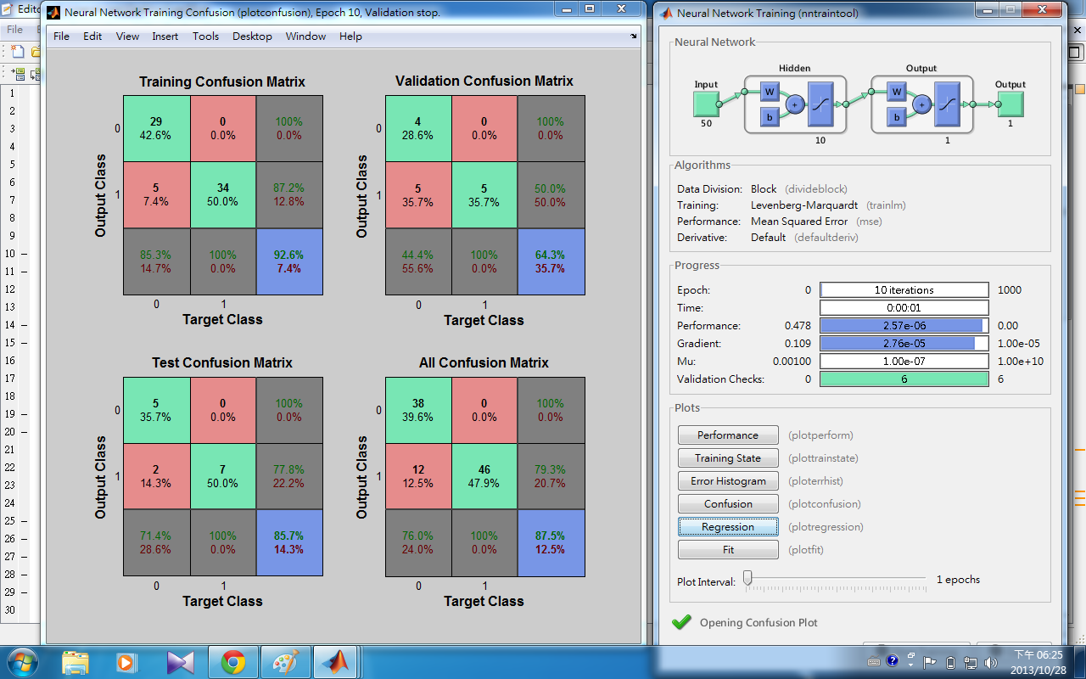
- 50 variables
Application – for breast cancer

Slide 18
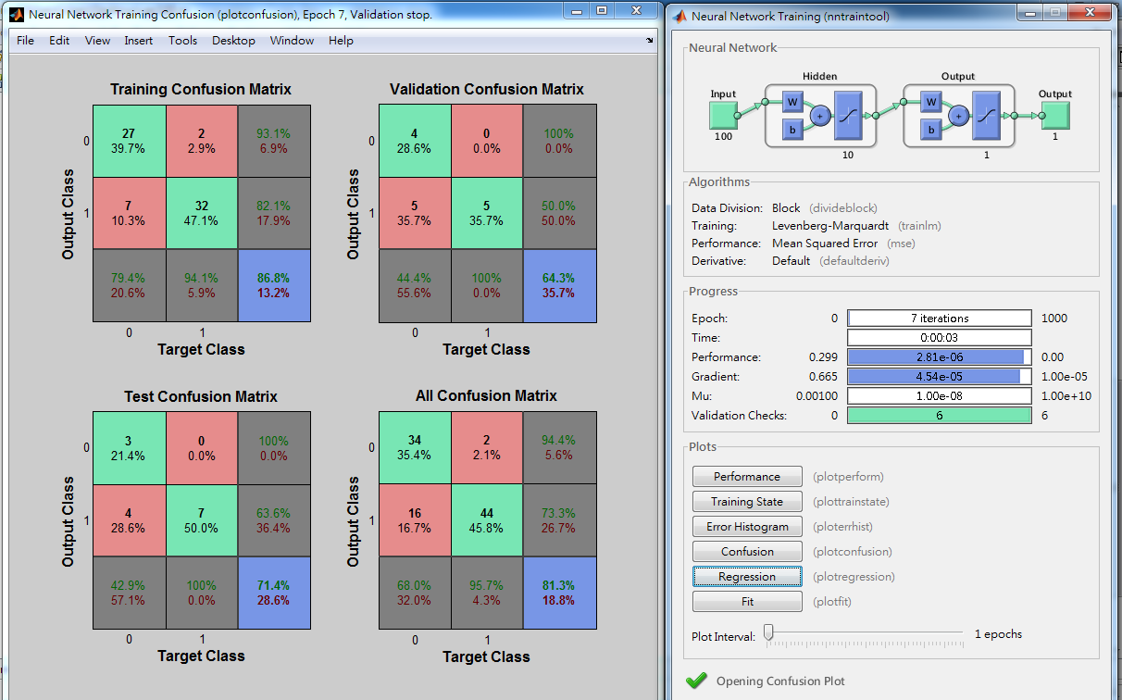
- 100 variables
Application – for breast cancer

Slide 19
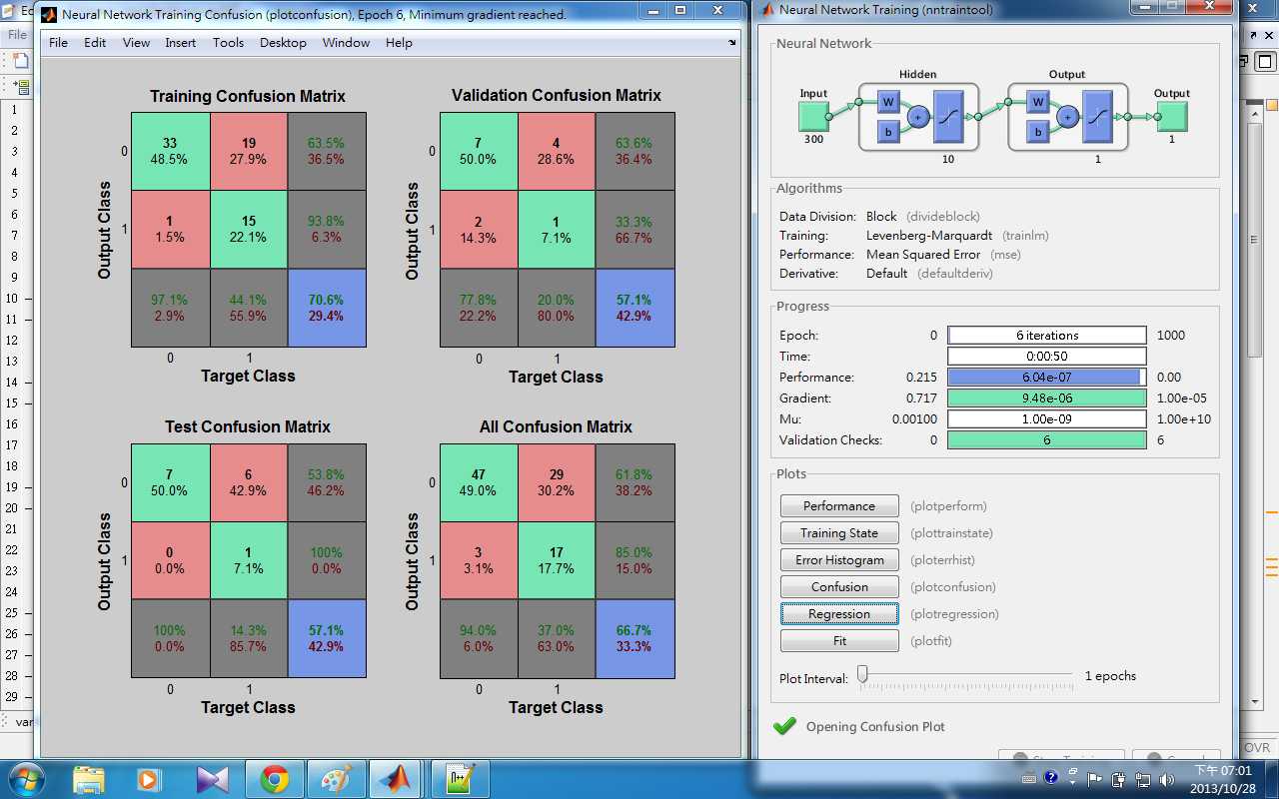
- 300 variables
Application – for breast cancer

Slide 20
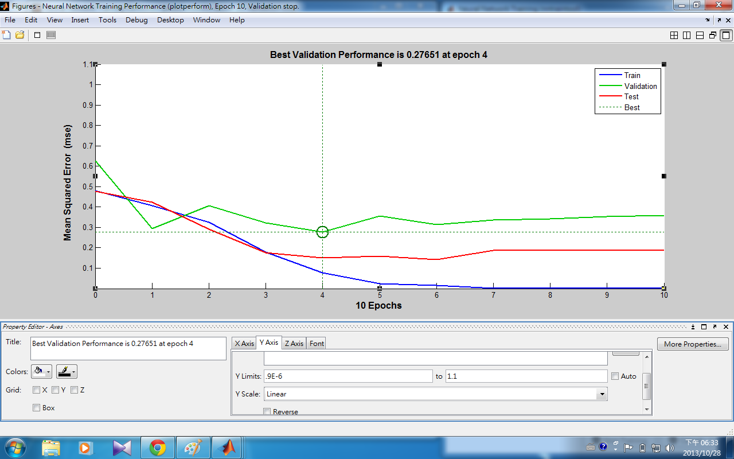
- 50 Variables : performance
Application – for breast cancer
- X axis:
label: epochs ( number of iterations )
- Y axis:
label: Mean Squared Error ( MSE )

Slide 21
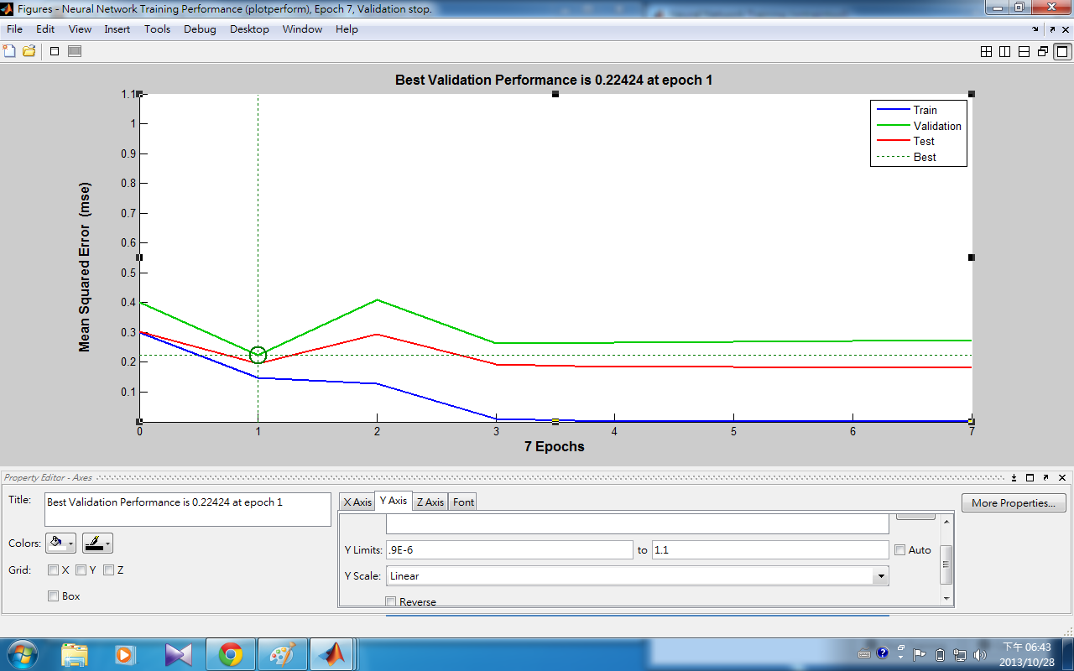
- 100 Variables : performance
Application – for breast cancer
- X axis:
label: epochs ( number of iterations )
- Y axis:
label: Mean Squared Error ( MSE )

Slide 22
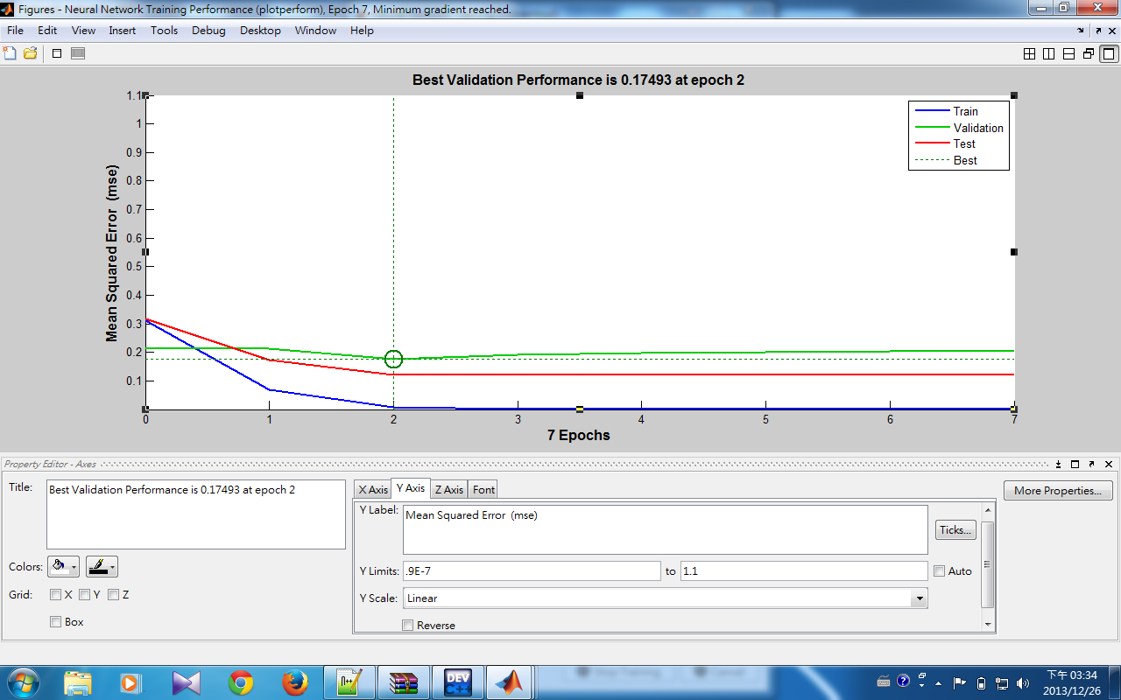
- 300 Variables: performance
Application – for breast cancer
- X axis:
label: epochs ( number of iterations )
- Y axis:
label: Mean Squared Error ( MSE )

Slide 23
Conclusion :
> About this project, I construct the BPN model by dataset about breast cancer, if a patient give the those 24481 genes, I can use the model to predict the patient will relapse or not after their initial diagnosis for interval of at least 5 years.
> I find the critical genes to determine relapse or not, if you give me the value of those critical genes, I just compare the value and get the prediction result.

Slide 24
Reference
[01] Jinyan Li, Huiqing Liu, Limsoon Wong. "Mean-entropy discretized features are effective for classifying high-dimensional biomedical data." The 3rd ACM SIGKDD Workshop on Data Mining in Bioinformatics , pages 17 - 24, 2003.
[02] “Kent Ridge Bio-medical Dataset”, available at:
” http://datam.i2r.a-star.edu.sg/datasets/krbd/index.html”, accessed on November.1.2013
[03] Jiawei Han and Micheline Kamber, “Data Mining Concepts and Techniques second edition”, MORGAN KAUFMANN, San Francisco, 2007
[04] Pete McCollum, “An Introduction to Back-Propagation Neural Networks”, available at:
“ http://www.seattlerobotics.org/encoder/nov98/neural.html “, accessed November.1.2013
[05] Mathworks, 2013, “Neural Network Toolbox”, available at:
“ http://www.mathworks.com/products/neural-network/ “, accessed November.1.2013
[06] Mathworks, 2013, “kmeans”, available at:” http://www.mathworks.com/help/stats/kmeans.html “
,accessed November.1.2013
[07] Mathworks, 2013, “ClassificationTree class”, available at:
“ http://www.mathworks.com/help/stats/classificationtreeclass.html “, accessed November.1.2013

Slide 25

Thank you
for your attention

Slide 26
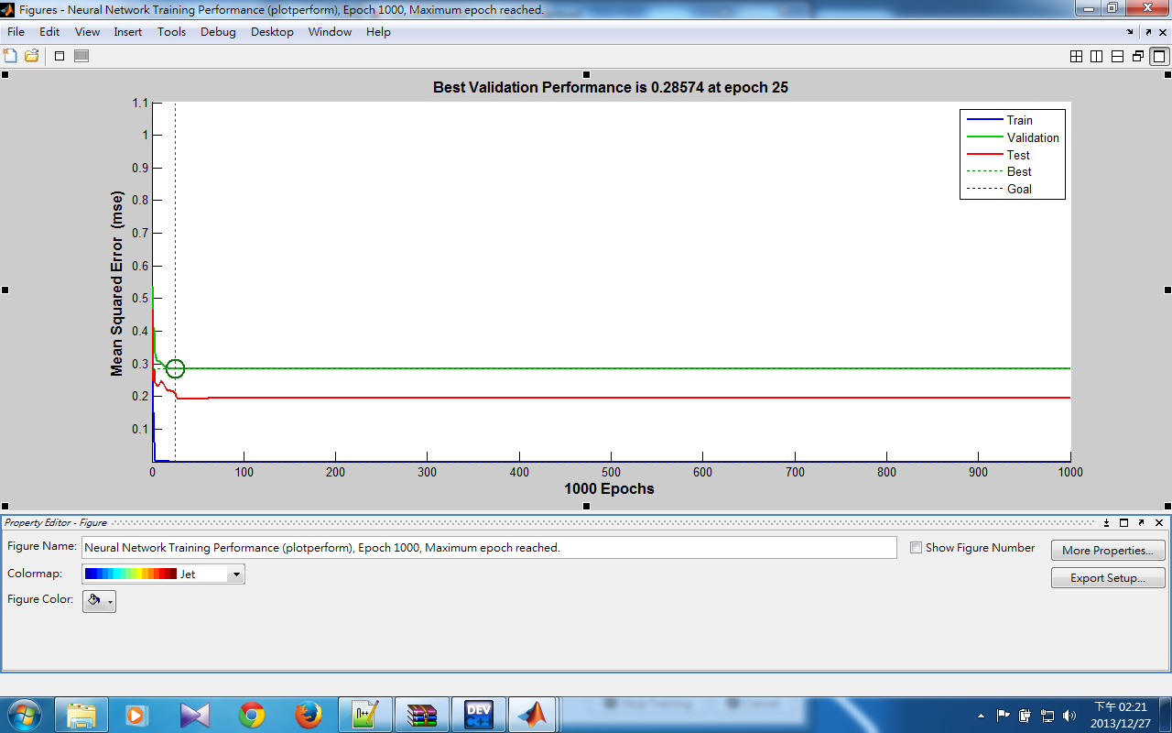
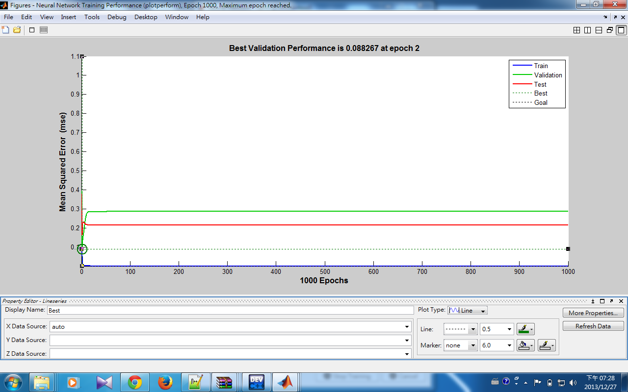
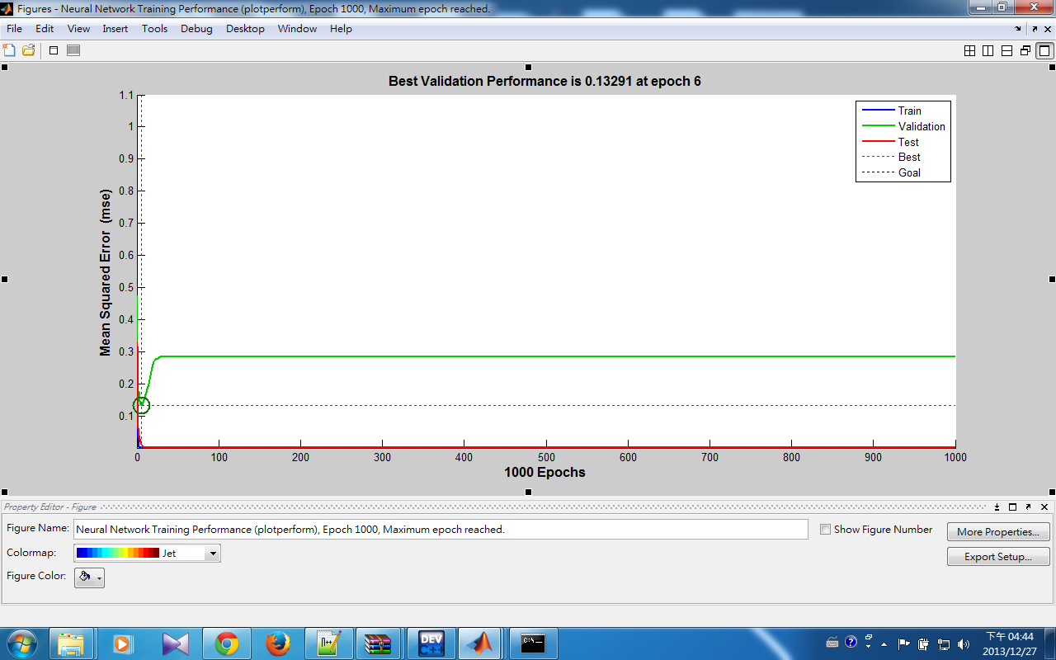
- 50 variables : performance(1000 ioolerations)
Appendix
Show the model performance
when 1000 iterations
- 100 variables : 1000 iterations
- 300 variables : 1000 iterations

Slide 27
Appendix II
100 variables performance :
We can see the 100 variables classification tree which is
highly symmetric, so we can predict that the entropy is
high => Difficult to predict the result by nntoolbox

